Slide 1
vaderSentiment
1
N-Gram
CONTENTS
2
Poem Processing
3
Plan for Next Week
4

Slide 2
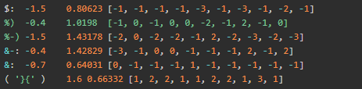
vaderSentiment: Lexicon structure
Column 1: word or phrase (token)
Column 2: mean sentiment rating
Column 3: standard deviation
Column 4: raw human sentiment rating
Notes:
Column 1: word or phrase (token)
Column 2: the average score of human emotion
Column 3: it is the standard deviation of the word, assuming that it follows a normal distribution
Column 4: This is a list of 10 people who scored the words in the experiment
Empirically validated by multiple independent human judges, VADER incorporates a "gold-standard" sentiment lexicon that is especially attuned to microblog-like contexts
The VADER sentiment lexicon is sensitive both the polarity and the intensity of sentiments expressed in social media contexts, and is also generally applicable to sentiment analysis in other domains.
Manually creating (much less, validating) a comprehensive sentiment lexicon is a labor intensive and sometimes error prone process, so it is no wonder that many opinion mining researchers and practitioners rely so heavily on existing lexicons as primary resources. We are pleased to offer ours as a new resource. We began by constructing a list inspired by examining existing well-established sentiment word-banks (LIWC, ANEW, and GI).

Slide 3
vaderSentiment: Vader structure
Two classes: sentitext (object) and sentimentintensity analyzer (object)
Four static methods negated(), normalize(), allcap_ differential()，scalar_ inc_ dec()
SentimentIntensityAnalyzer(object):
Returns a floating-point value of emotional strength based on the input text. Positive values are positive emotions and negative values are negative emotions.
Use certain rules to calculate the score of words in sentences
The emotional intensity of the whole sentence is calculated according to the score of each word
Notes:
Empirically validated by multiple independent human judges, VADER incorporates a "gold-standard" sentiment lexicon that is especially attuned to microblog-like contexts
The VADER sentiment lexicon is sensitive both the polarity and the intensity of sentiments expressed in social media contexts, and is also generally applicable to sentiment analysis in other domains.

Slide 4
N-Gram: Beyond UnigramC
Native Bayes:
p(‘I love deep learning’ I J) = p(‘I’, ‘love’, ‘deep’, ‘learning’| J)
= p(‘I’ | J) p(‘love’ | J) p(‘deep’ | J) p(‘learning’ | J)
Bag-of-Words:
p(‘I love deep learning’ I J) = p(‘Deep learning love I’ | J) ?
Notes:
The first histogram equalization we just saw, considers the global contrast of the image. In many cases, it is not a good idea. For example, below image shows an input image and its result after global histogram equalization.
It is true that the background contrast has improved after histogram equalization. But compare the face of statue in both images. We lost most of the information there due to over-brightness. It is because its histogram is not confined to a particular region as we saw in previous cases (Try to plot histogram of input image, you will get more intuition).
So to solve this problem, adaptive histogram equalization is used. In this, image is divided into small blocks called "tiles" (tileSize is 8x8 by default in OpenCV). Then each of these blocks are histogram equalized as usual. So in a small area, histogram would confine to a small region (unless there is noise). If noise is there, it will be amplified. To avoid this, contrast limiting is applied. If any histogram bin is above the specified contrast limit (by default 40 in OpenCV), those pixels are clipped and distributed uniformly to other bins before applying histogram equalization. After equalization, to remove artifacts in tile borders, bilinear interpolation is applied.

Slide 5
N-Gram: IntroductionC
Features:
(1) The appearance of a word/letter depends on several other words/letter
(2) The more information we get, the more accurate the prediction is
Bigrams:
*C, CO, OM, MP, PU, UT, TE, ER, R*
Trigrams:
**C, *CO, COM, OMP, MPU, PUT, UTE, TER, ER*, R**
Notes:
N-gram model is a language model (LM). Language model is a discriminant model based on probability. Its input is a sentence (sequence of words), and its output is the probability of the sentence, that is, the joint probability of these words
N-gram itself also refers to a set of n nn words, each word has a sequence, and does not require that the words are different from each other. Commonly used are Bi gram (n = 2, n = 2n = 2) and tri gram (n = 3, n = 3N = 3), which are generally enough.

Slide 6

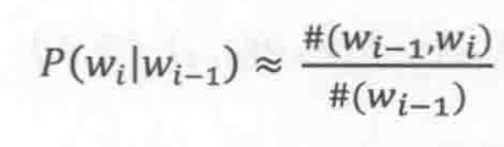
N-Gram: N-Gram in Language Model
In a bigram LM, given w_{i}, the probability that the next word is w_{j} is given by:
(1) character based
(2) word based
Markov Assumption:
Notes:
The appearance of a word is only related to several words before it

Slide 7

N-Gram: N-Gram in Language Model
Calculate each conditional probability:
‘I am Sam.
Sam I am.
I do not like eggs and ham.’
P(am | I) = 2/3
Notes:
The appearance of a word is only related to several words before it

Slide 8
N-Gram: Applications
Similarity:
S=2C/(A+B), where A and B are the number of unique bigrams in the pair of words; C is the number of common bigrams.
Pos tagging:
‘Answer’ ⬅➔ n. / v. ?
Tokenizer:
S = ‘I love deep learning’
Y₁ = {‘I’, ‘love deep’, ‘learning’}
Y₂ = {‘I love’, ‘deep’, ‘learning’}
Y₃ = {‘I’, ‘love’, ‘deep learning’ }
p(Y₁) = p(I)p(love deep | I)p(learning | love deep)
p(Y₂) = p(I love)p(deep | I love)p(learning | deep)
P(Y₃) = p(I)p(love | I)p(deep learning | love)
Notes:
Multi classification problem

Slide 9
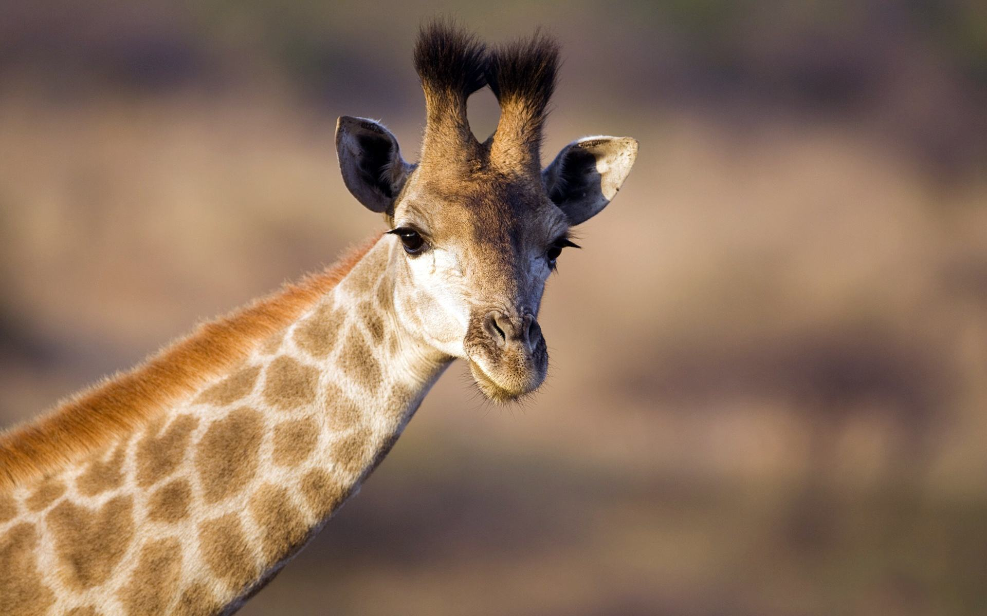
Thanks for listening
2021

